Slide 1


Database System Architecture
& Data Models
Prof. Shital Pathar, Prof. Abhijitsinh Parmar, Assistant Professor,
Computer science & Engineering

Slide 2
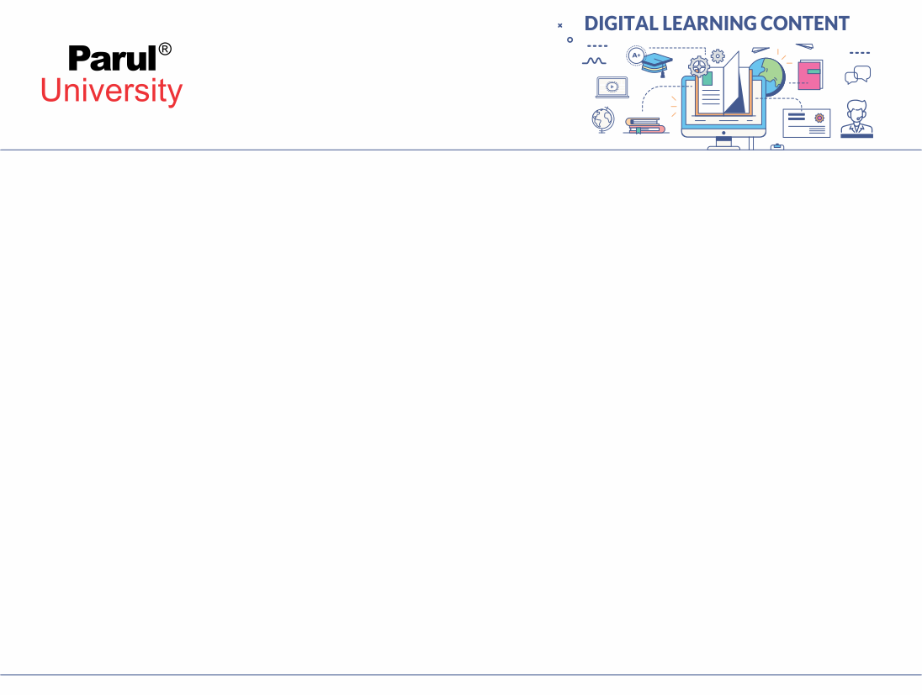

CHAPTER-1
Database System architecture

Slide 3
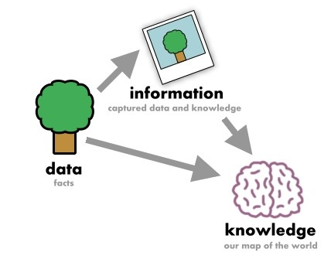
Introduction
Data - Fact that can be recorded or stored
e.g. Person Name, Age, Gender and Weight etc.
Information
When data is processed, organized, structured or presented in a given context so as to make it useful, it is called information.
knowledge
It is the appropriate collection of information
Figure: 1.1 An example of Data,information and knowledge
(Image Source : https://images.app.goo.gl/cbtcdV1EMn3SoWzi7)

Slide 4
What is DBMS?
of DBMS
DBMS (Database Management System= Database + Set of programs
Database:-A Collection of logically related data.
e.g. Books Database in Library, Student Database in University etc.
Management - Manipulation, Searching and Security of data
e.g. Viewing result in GTU website, Searching exam papers in GTU website etc.
System - Programs or tools used to manage database
e.g. SQL Server Studio Express, Oracle etc.
DBMS - Database Management System (DBMS) is a software designed to define, manipulate, retrieve and manage data in a database.
e.g. MS SQL Server, Oracle, My SQL, SQLite, MongoDB etc.

Slide 5


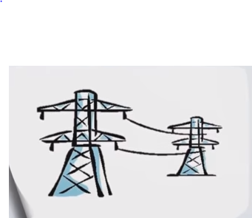

Examples of DBMS
Online Telephone Directory
Electricity Service provider
Facebook
Whatsapp
etc
Figure: 1.2 Online Telephone Directory
(Image Source : https://images.app.goo.gl/cbtcdV1EMn3SoWzi7)
Figure:1.5 Whatsapp
(Image Source
https://images.app.goo.gl/cbtcdV1EMn3SoWzi7)
Figure: 1.4 Facebook
(Image Source : ttps://images.app.goo.gl/cbtcdV1EMn3SoWzi7)
Figure: 1.3 Electricity Service provider
(Image Source : https://images.app.goo.gl/cbtcdV1EMn3SoWzi7)

Slide 6
Database System Applications
DBMS is a computerized record-keeping system.
DBMS is required where ever data need to be stored.
E-Commerce (Flikart, Amazon, Shopclues, eBay etc...)
Online Television Streaming (Hotstar, Amazon Prime etc...)
Social Media (WhatsApp, Facebook, Twitter, LinkedIn etc...)
Banking & Insurance
Airline & Railway
Universities and Colleges/Schools
Library Management System
Human Resource Department
Hospitals and Medical Stores
Government Organizations

Slide 7
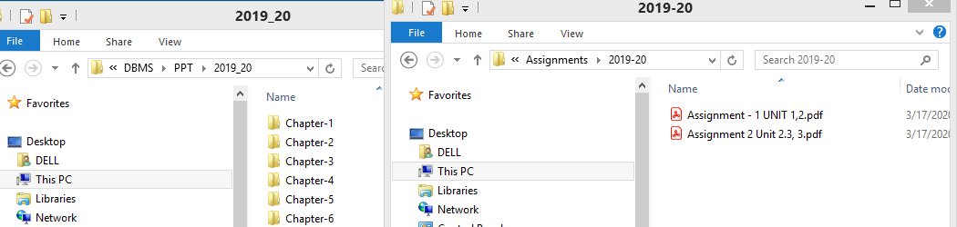
File Processing System (FPS) or File System
In Computer Science, File Processing System (FPS) is a way of storing, retrieving and manipulating data which is present in various files.
Figure: 1.6 An example of File Processing System

Slide 8
Advantages of File Processing System
Cost friendly – There is a very minimal to no set up and usage fee for File Processing System. (In most cases, free tools are inbuilt in computers.)
Easy to use – File systems require very basic learning and understanding, hence, can be easily used.
High scalability – One can very easily switch from smaller to larger files as per his needs.

Slide 9
Disadvantages of File Processing System
Data redundancy and inconsistency
Multiple file formats, duplication of information in different files
Difficulty in accessing data
Need to write a new program to carry out each new task
Data isolation- data are scattered in various files, and files may be in different formats, writing new application programs to retrieve the appropriate data is difficult.
Integrity problems- when new constraints are added, it is difficult to change the programs to enforce them.

Slide 10
Disadvantages of File Processing System
Atomicity problems
Failures may leave database in an inconsistent state with partial updates carried out
Example: Transfer of funds from one account to another should either complete or not happen at all
Concurrent-access by multiple users
Example: Two people reading a balance (say 100) and updating it by withdrawing money (say 50 each) at the same time
Security problems
Poor data control
Limited data sharing
Excessive programming effort

Slide 11
Application of DBMS
Providing Application Flexibility with Relational Databases.
Object oriented Applications and the need for more complex Databases.
Early DB Applications
Extending DB capabilities for new applications

Slide 12
Advantages of DBMS over file management system.
Minimal data redundancy
Program data independence
Efficient data access
Improved data sharing
Improved security
Economy of scale
Reduced program maintenance
Improved Backup
Improved data quality

Slide 13
Purpose of DBMS
Compactness- no need of paper work
Speed
Accuracy
Protection

Slide 14
Benefits of DB Approach
Data can be Shared
Redundancy can be reduced
Inconsistency can be avoided
Security can be enforced
Conflicting requirements can be balanced
Integrity can be maintain

Slide 15
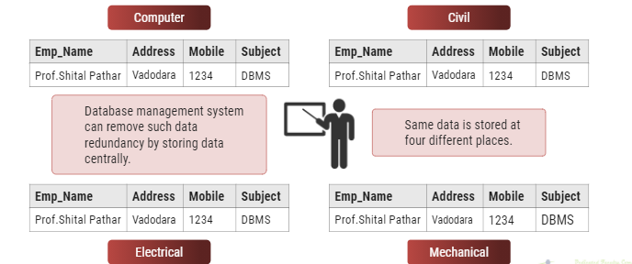
Advantages of DBMS
Reduce data redundancy (duplication)
Figure: 1.7 An example of data redundancy
(Image Source : https://www.researchgate.net/figure/An-example-of-redundancy-of-data-and-functionality_fig1_266550024)

Slide 16
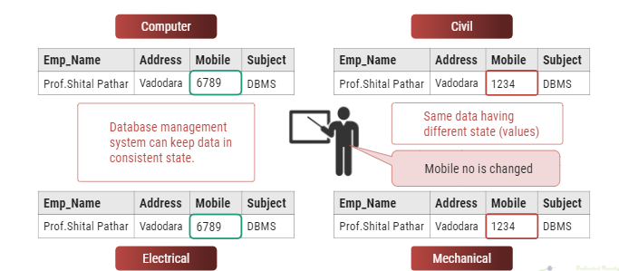
Remove data inconsistency
Figure: 1.8 An example of data inconsistency
(Image Source : ttps://www.quora.com/What-is-data-inconsistency-1)

Slide 17
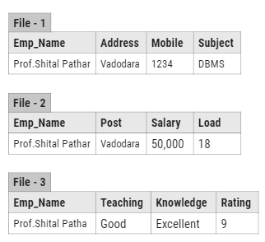
Data isolation
Data are scattered in various files.
Files may be in different formats.
Difficult to retrieve the appropriate data.
DBMS allow us to access (retrieve) appropriate data easily.
Data isolation is a property that determines when and how changes made by one operation become visible to other concurrent users and systems.
This issue occurs in a concurrency situation.
Figure: 1.9 An example Data isolation
(Image Source : https://www.researchgate.net/figure/Example-of-data-isolation-problem_fig1_278658528)

Slide 18
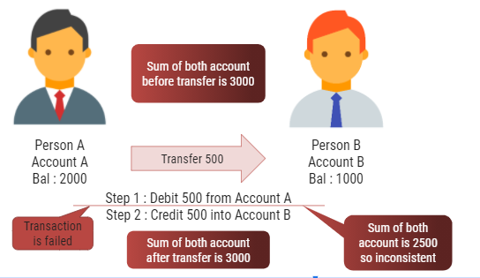
Guaranteed atomicity
Atomicity: Either transaction execute 0% or 100%.
Figure: 1.10 An example of atomicity
(Image Source : https://encrypted-tbn0.gstatic.com/images?q=tbn%3AANd9GcSVFDVbwXtsq94f6HGuntRnVsOaz27Xnw-Lew&usqp=CAU)

Slide 19
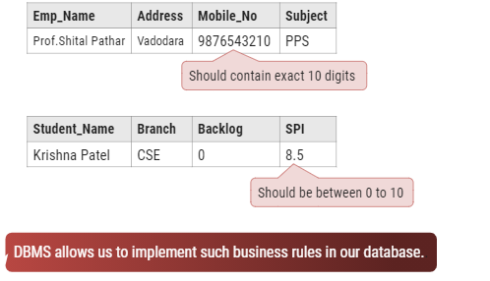
Allow to implement integrity constraints
Figure: 1.11 An example integrity constraints
(Image Source : http://www.allfordrugs.com/data-integrity/)

Slide 20
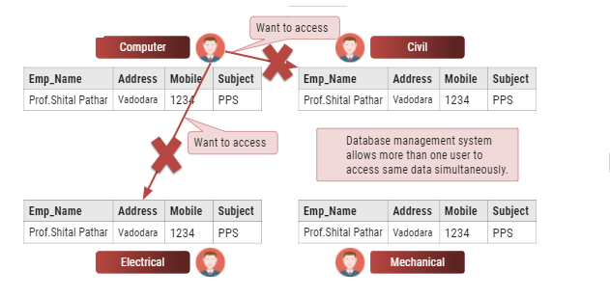
Sharing of data among multiple users
Figure: 1.12 An example of Sharing
(Image Source : http://www.allfordrugs.com/data-integrity/)

Slide 21
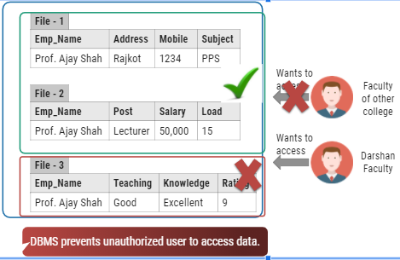
Restricting unauthorized access to data
Figure: 1.13 An example of unauthorized access to data
(Image Source : ttps://www.mageplaza.com/kb/your-web-server-set-up-incorrectly-allows-unauthorized-access-sensitive-files-magento-2.html)

Slide 22
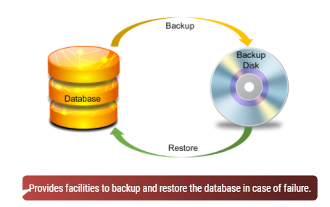
Providing backup and recovery services
Figure: 1.14 An example of backup and recovery services
(Image Source : https://www.enterprisestorageforum.com/backup-recovery/enterprise-backup-and-recovery-software.html)

Slide 23
Advantages of DBMS (Summary)
Reduce data redundancy (duplication)
Avoids unnecessary duplication of data by storing data centrally.
Remove data inconsistency
By eliminating redundancy, data inconsistency can be removed.
Data isolation
A user can easily retrieve proper data as per his/her requirement.
Guaranteed atomicity
Either transaction executes 0% or 100%.

Slide 24
Advantages of DBMS (Summary)
Allow implementing integrity constraints
Business rules can be implemented such as do not allow to store amount less than Rs. 0 in balance.
Sharing of data among multiple users
More than one users can access same data at the same time.
Restricting unauthorized access to data
A user can only access data which is authorized to him/her.
Providing backup and recovery services
Can take a regular auto or manual backup and use it to restore the database if it corrupts.

Slide 25
Basic Terms of DBMS
Data
Data is raw, unorganized facts that need to be processed.
Example: Marks of students
Student_1 = 50/100, Student_2 = 25/100.
Information
When data is processed, organized, structured or presented in a given context so as to make it useful, it is called information.
Example: Result of students (Pass or Fail)
Student_1 = Pass, Student_2 = Fail.

Slide 26

Basic Terms of DBMS
Metadata
Metadata is data about data.
Data such as table name, column name, data type, authorized user and user access privileges for any table is called metadata for that table.
Metadata of above table is:
Table name such as Faculty
Column name such as Emp_Name, Address, Mobile_No, Subject
Datatype such as Varchar, Decimal
Access privileges such as Read, Write (Update)
Figure: 1.15 An example of Metadata
(Image Source : https://images.app.goo.gl/cbtcdV1EMn3SoWzi7)

Slide 27

Basic Terms of DBMS
Data dictionary:-A data dictionary is an information repository which contains metadata.
Figure: 1.16 An example of data dictionary
(Image Source : https://dataedo.com/kb/data-glossary/what-is-data-dictionary)

Slide 28
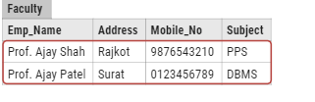
Basic Terms of DBMS
Data warehouse
A data warehouse is an information repository which stores data.
Figure: 1.17 An example of warehouse
(Image Source : https://images.app.goo.gl/cbtcdV1EMn3SoWzi7)

Slide 29
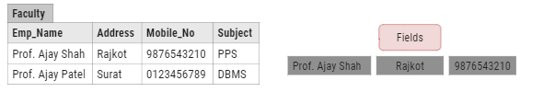
Basic Terms of DBMS
Field
A field is a character or group of characters that have a specific meaning.
E.g, the value of Emp_Name, Address, Mobile_No etc are all fields of Faculty table.
Figure: 1.18 An example of field
(Image Source : https://images.app.goo.gl/cbtcdV1EMn3SoWzi7)

Slide 30

Basic Terms of DBMS
Record / Tuple
A record is a collection of logically related fields.
E.g, the collection of fields (Emp_Name, Address, Mobile_No, Subject) forms a record for the Faculty.
Figure: 1.19 An example of Record
(Image Source : https://images.app.goo.gl/cbtcdV1EMn3SoWzi7)

Slide 31
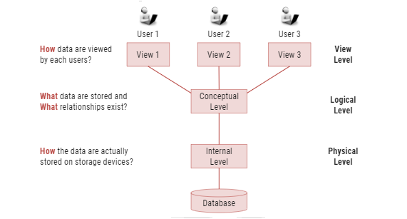
3 Levels ANSI SPARC Database System
Figure: 1.20 ANSI SPARC Database System
(Image Source : https://pt.slideshare.net/NurHidayahKhazali/chapter-2-database-environment/13)

Slide 32
Internal Level
The internal level has an internal schema which describes the physical storage structure of the database.
The internal schema is also known as a physical schema.
It uses the physical data model. It is used to define that how the data will be stored in a block.
The physical level is used to describe complex low-level data structures in detail.

Slide 33
Conceptual Level
The conceptual schema describes the design of a database at the conceptual level. Conceptual level is also known as logical level.
The conceptual schema describes the structure of the whole database.
The conceptual level describes what data are to be stored in the database and also describes what relationship exists among those data.
In the conceptual level, internal details such as an implementation of the data structure are hidden.
Programmers and database administrators work at this level.

Slide 34
External Level
At the external level, a database contains several schemas that sometimes called as subschema. The subschema is used to describe the different view of the database.
An external schema is also known as view schema.
Each view schema describes the database part that a particular user group is interested and hides the remaining database from that user group.
The view schema describes the end user interaction with database systems.

Slide 35
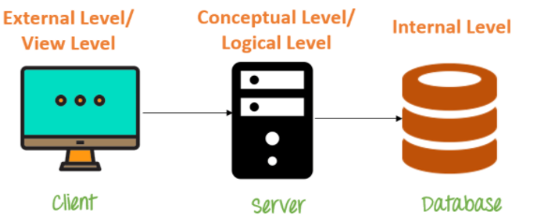
Data Abstraction in DBMS
Database systems are made-up of complex data structures.
To ease the user interaction with database, the developers hide internal irrelevant details from users.
This process of hiding irrelevant details from user is called data abstraction.
Figure: 1.21 An example of Data Abstraction
(Image Source : https://prepinsta.com/dbms/data-abstraction-and-data-independence/)

Slide 36
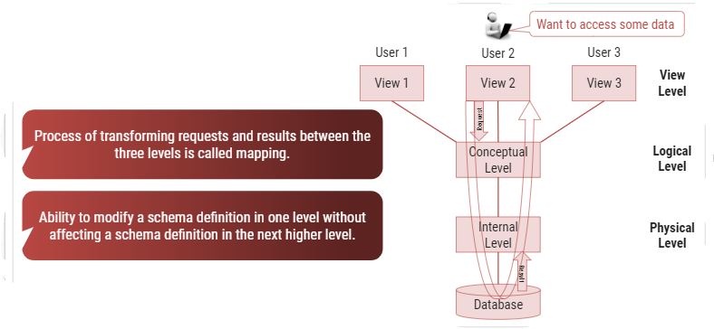
Mapping and Data Independence
Figure1.22: Mapping and Data Independence
(Image Source : https://images.app.goo.gl/cbtcdV1EMn3SoWzi7)

Slide 37
Types of Data Independence
Physical Data Independence
Physical Data Independence is the ability to modify the physical schema without requiring any change in logical (conceptual) schema and application programs.
Modifications at the internal levels are occasionally necessary to improve performance.
Possible modifications at internal levels are changes in file structures, compression techniques, hashing algorithms, storage devices, etc.

Slide 38
Types of Data Independence
Logical Data Independence
Logical data independence is the ability to modify the conceptual schema without requiring any change in application programs.
Modification at the logical levels is necessary whenever the logical structure of the database is changed.
Application programs are heavily dependent on logical structures of the data they access. So any change in logical structure also requires programs to change.

Slide 39
Types of Database Users
Naive Users (End Users)
Unsophisticated users who have zero knowledge of database system
End user interacts to database via sophisticated software or tools
e.g. Clerk in bank
Application Programmers
Programmers who write software using tools such as Java, .Net, PHP etc…
e.g. Software developers

Slide 40
Types of Database Users
Sophisticated Users
Interact with database system without using an application program
Use query tools like SQL
e.g. Analyst
Specialized Users (DBA)
User write specialized database applications program
Use administration tools
e.g. Database Administrator

Slide 41
Role of DBA (Database Administrator)
Schema Definition
DBA defines the logical schema of the database.
Storage Structure and Access Method Definition
DBA decides how the data is to be represented in the database & how to access it.
Defining Security and Integrity Constraints
DBA decides on various security and integrity constraints.
Granting of Authorization for Data Access
DBA determines which user needs access to which part of the database.
Liaison with Users
DBA provide necessary data to the user.

Slide 42
Role of DBA
Assisting Application Programmer
DBA provides assistance to application programmers to develop application programs.
Monitoring Performance
DBA ensures that better performance is maintained by making a change in the physical or logical schema if required.
Backup and Recovery
DBA backing up the database on some storage devices such as DVD, CD or magnetic tape or remote servers and recover the system in case of failures, such as flood or virus attack from this backup.

Slide 43
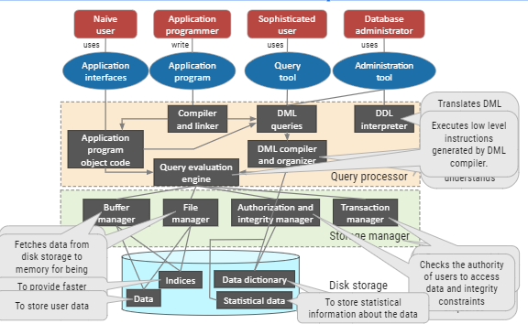
Database System Architecture
Figure: 1.23 Database System Architecture
(Image Source : https://www.researchgate.net/figure/The-general-system-architecture-of-federated-database-systems-with-database-wrappers-as_fig3_272293869)

Slide 44
Structured Query Language(SQL)
SQL stands for Structured Query Language
SQL lets you access and manipulate databases
SQL became a standard of the American National Standards Institute (ANSI) in 1986, and of the International Organization for Standardization (ISO) in 1987

Slide 45
What Can SQL do?
SQL can execute queries against a database
SQL can retrieve data from a database
SQL can insert records in a database
SQL can update records in a database
SQL can delete records from a database
SQL can create new databases
SQL can create new tables in a database
SQL can create stored procedures in a database
SQL can create views in a database
SQL can set permissions on tables, procedures, and views

Slide 46
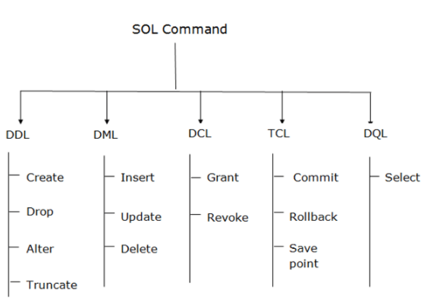
SQL Commands
SQL commands are instructions. It is used to communicate with the database. It is also used to perform specific tasks, functions, and queries of data.
Figure: 1.24 SQL Commands
(Image Source : https://www.google.com/imgres?imgurl=https%3A%2F%2Fstatic.javatpoint.com%2Fdbms%2Fimages%2Fdbms-sql-command.png&imgrefurl=http)

Slide 47
Data Definition Language (DDL)
DDL changes the structure of the table like creating a table, deleting a table, altering a table, etc.
All the command of DDL are auto-committed that means it permanently save all the changes in the database.
Here are some commands that come under DDL:
CREATE
ALTER
DROP
TRUNCATE

Slide 48
Data Definition Language (DDL Command)
CREATE It is used to create a new table in the database.
Syntax:
CREATE TABLE TABLE_NAME (COLUMN_NAME DATATYPES[,....]);
Example:
CREATE TABLE EMPLOYEE(Name VARCHAR2(20), Email VARCHAR2(100), DOB DATE);

Slide 49
Data Definition Language (DDL Command)
DROP: It is used to delete both the structure and record stored in the table.
Syntax
DROP TABLE ;
Example
DROP TABLE EMPLOYEE;

Slide 50
Data Definition Language (DDL Command)
ALTER: It is used to alter the structure of the database. This change could be either to modify the characteristics of an existing attribute or probably to add a new attribute.
Syntax:
To add a new column in the table
ALTER TABLE table_name ADD column_name COLUMN-definition;
To modify existing column in the table:
ALTER TABLE MODIFY(COLUMN DEFINITION....);
EXAMPLE:
ALTER TABLE STU_DETAILS ADD(ADDRESS VARCHAR2(20));
ALTER TABLE STU_DETAILS MODIFY (NAME VARCHAR2(20));

Slide 51
Data Definition Language (DDL Command)
TRUNCATE: It is used to delete all the rows from the table and free the space containing the table.
Syntax:
TRUNCATE TABLE table_name;
Example:
TRUNCATE TABLE EMPLOYEE;

Slide 52
Data Manipulation Language(DML)
DML commands are used to modify the database. It is responsible for all form of changes in the database.
The command of DML is not auto-committed that means it can't permanently save all the changes in the database. They can be rollback.
Here are some commands that come under DML:
INSERT
UPDATE
DELETE

Slide 53
Data Manipulation Language(DML Commands)
INSERT: The INSERT statement is a SQL query. It is used to insert data into the row of a table.
Syntax:
INSERT INTO TABLE_NAME (col1, col2, col3,.... col N)
VALUES (value1, value2, value3, .... valueN);
Or
INSERT INTO TABLE_NAME
VALUES (value1, value2, value3, .... valueN);
For example:
INSERT INTO BOOK (Author, Subject) VALUES ("Shital", "DBMS");

Slide 54
Data Manipulation Language(DML Commands)
UPDATE: This command is used to update or modify the value of a column in the table.
Syntax:
UPDATE table_name SET [column_name1= value1,...column_nameN = valueN] [WHERE CONDITION]
For example:
UPDATE students SET User_Name = 'Shital WHERE Student_Id = '3'

Slide 55
Data Manipulation Language(DML Commands)
DELETE: It is used to remove one or more row from a table.
Syntax:
DELETE FROM table_name [WHERE condition];
For example:
DELETE FROM Book WHERE Author="Shital";

Slide 56
Data Control Language(DCL)
DCL commands are used to grant and take back authority from any database user.
Here are some commands that come under DCL:
Grant
Revoke

Slide 57
Data Control Language(DCL Commands)
Grant: It is used to give user access privileges to a database.
Example
GRANT SELECT, UPDATE ON MY_TABLE TO SOME_USER, ANOTHER_USER;
Revoke: It is used to take back permissions from the user.
Example
REVOKE SELECT, UPDATE ON MY_TABLE FROM USER1, USER2;

Slide 58
Transaction Control Language(TCL)
TCL commands can only use with DML commands like INSERT, DELETE and UPDATE only.
These operations are automatically committed in the database that's why they cannot be used while creating tables or dropping them.
Here are some commands that come under TCL:
COMMIT
ROLLBACK
SAVEPOINT

Slide 59
Transaction Control Language(TCL Commands)
Commit: Commit command is used to save all the transactions to the database.
Syntax:-COMMIT;
Example:
DELETE FROM CUSTOMERS WHERE AGE = 25;
COMMIT;

Slide 60
Transaction Control Language(TCL Commands)
Rollback: Rollback command is used to undo transactions that have not already been saved to the database.
Syntax:-ROLLBACK;
Example:
DELETE FROM CUSTOMERS WHERE AGE = 25;
ROLLBACK;

Slide 61
Transaction Control Language(TCL Commands)
3. SAVEPOINT: It is used to roll the transaction back to a certain point without rolling back the entire transaction.
Syntax:-SAVEPOINT SAVEPOINT_NAME;

Slide 62
DATA MODELS

Slide 63
Data Models
Data models re how the logical structure of a database is designed.
Data Models are fundamental entities to introduce abstraction in a DBMS.
Data models define how data is connected to each other and how they are processed and stored inside the system.
It defines how data can be stored, accessed and updated in database management systems.

Slide 64
Data Models
There are different types of data models in DBMS:-
ER(Entity-Relationship)- Model
Relational Model
Network Model
Object Oriented Model

Slide 65
ER Model
Basic Concepts:-
What is E-R diagram?
E-R diagram means Entity-Relationship diagram
It is a visual tool for graphical (pictorial) representation of database.
ER Model was proposed by Peter Chen in 1970’s to use it for a conceptual modelling/designing of database.

Slide 66
ER Model
Basic Concepts:-
What is E-R diagram?
It is based on the view of real-world entities and relationships among them.
While expressing real-world scenario into the database model, the ER Model creates entity set, relationship set, general attributes and constraints.
ER Model mainly focuses on Entities and their attributes and Relationships among entities.
It uses various types of symbols to represent objects of database.

Slide 67
Entity
Entity is real-world objects, place, person about which we collect data
Example: For University database entity can be Student, Teacher, Department, Course, Result, Class, etc.
Entity is denoted by a Rectangle containing name of entity.
Entity Name
Student
Course
Figure: 1.25 Entity

Slide 68
Attributes
Attribute represent properties or details about an entity.
Example: For student entity, attributes can be name, enrollment no, address, date of birth, result, etc.
It is denoted by an oval symbol having name of an attribute.
Name
En No
Attribute Name
Student
Figure: 1.26 Attributes

Slide 69
Relationship
Relationship is an association/connection between several entities.
It defines how entities are related to each other.
It is denoted by a diamond containing relationship's name.
Diamond should be placed between two entities and a line connecting to both entity.
Example: Book from library is issued by student, here book & student are entities and issue is relationship.
Relationship Name
Student
Issue
Book
Figure:1.27 Relationship

Slide 70
Entity Set
Entity Set is a set of entities of the same type having same properties or attributes.
Example: set of all persons, companies, trees, holidays, all students studying in a university
Relationship Set: When there are set of relationships of a same type is called Relationship set

Slide 71
E-R Diagram of Library Management System
Primary Key
Attributes
RollNo
Name
Relationship
BookNo
Name
Student
Issue
Book
Branch
Sem
Entities
Author
Price
Figure: 1.28 An example of E-R Diagram

Slide 72
Types of Attributes
Let’s understand different types of attributes
Simple and composite attributes.
Single-valued and multi-valued attributes
Stored attribute and Derived attributes
Complex Attribute
Key Attribute

Slide 73
1. Simple and composite attributes
Simple Attribute:
It cannot be divided further in more subparts.
It is like undivided atomic value.
Example: Price, Year, Enno, CPI
CPI
Figure: 1.29 Simple Attribute

Slide 74
1. Simple and composite attributes
Composite Attribute:
It can be divided further in more subparts.
It is an attribute composed of many other attributes.
Example: Name
(first name, middle name, last name)
Address
(street, road, city)
Name
First name
Last name
Middle name
Figure: 1.30 Composite Attribute

Slide 75
2. Single-valued and multi-valued attributes
Single-Valued Attribute:
As name suggests it has single value only.
Example: Enno, Birthdate
Birthdate
Figure: 1.31 Single-valued Attribute

Slide 76
2. Single-valued and multi-valued attributes
Multi-Valued Attribute:
It has multiple/more than one values.
Example: PhoneNo
(person may have multiple phone nos)
EmailID
(person may have multiple emails)
EmailID
Figure: 1.32 Multi-valued Attribute

Slide 77
3. Stored attribute and Derived attributes
Stored Attribute:
In this attribute value needs to be stored/defined manually.
Example: Birthdate, Height, Weight
Height
Figure: 1.33 Stored Attribute

Slide 78
3. Stored attribute and Derived attributes
Derived Attribute:
Derived attribute value can be calculated or derived from other attributes.
Example: Age (Can be derived from current date and birth date)
Age
Figure: 1.34 Derived Attribute

Slide 79
4. Complex Attribute
Attribute that are derived by nesting the composite and multivalued attributes are called complex attributes.
Address_ phone((phone), address (H.no., city, state))
Complex Attribute MV Attribute Composite Attribute

Slide 80
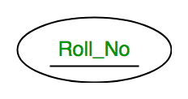
5. Key Attribute
Attribute which uniquely identifies each entity in the entity set is called key attribute.
For example, RollNo will be unique for each student.
It is denoted by an oval with underlying lines.
Figure: 1.35 Key Attribute

Slide 81
Example of All Attributes
Middle Name
First Name
Last Name
RollNo
Name
Apartment
Student
Street
Age
Address
Phone No
Birth Date
Area
Figure: 1.36 An example of all Attributes

Slide 82
Descriptive Attributes
If any relationship has a attribute like entity then its known as Descriptive Attributes.
Example: Student had been issued degree certificate on 25/5/2020. Certificate date is an attribute of relationship.
RollNo
Name
Student
issue
Certificate
Descriptive Attribute
Branch
Subjects
Issue Date
Name
CertiNo
Figure: 1.37 Descriptive Attributes

Slide 83
Recursive Relationship Set
When one entity set participate in a relationship for more than once then it is called recursive relationship set.
FacID
FName
DeptID
DName
Works
Faculty
Department
Recursive Relationship
Set
Post
FName | Post
Ankita | HOD
Krunal | Professor
Sumitra | HOD
DName
Computer
Electrical
IT
Prof.
Figure: 1.38 Recursive Relationship set

Slide 84
Degree of a Relationship Set
Number of entity sets joining in a relationship set is known as a degree of a relationship set.
Unary Relationship
Binary Relationship
n-ary Relationship

Slide 85
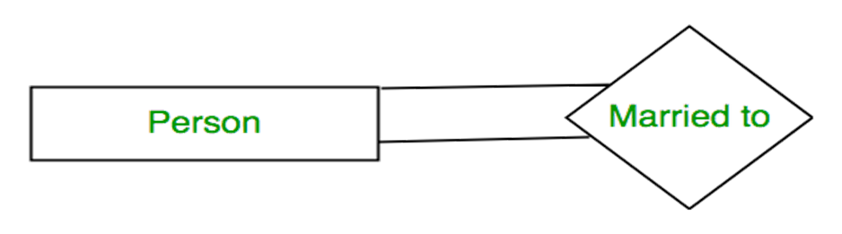
Degree of a Relationship Set
Unary Relationship:
When only one entity set participating in a relationship is called Unary Relationship.
Example: One person is married to only one person.
Figure: 1.39 Unary Relationship

Slide 86
Degree of a Relationship Set
2. Binary Relationship:
When Two entity set participating in a one relationship is called Binary Relationship.
Example: Student is Enrolled in Course
Student
Enrolled in
Course
Figure: 1.40 Binary Relationship

Slide 87
Degree of a Relationship Set
3. N-ary / Ternary Relationship:
When there are 3 or N entity set participating in a relationship is called Ternary / N-ary Relationship.
ProjectID
Project Name
Project
FacID
Name
RollNo
Name
Faculty
Guide
Student
Branch
Technology
Branch
Sem
Figure: 1.41 Ternary Relationship

Slide 88
Cardinality Constraints (Mapping Cardinality)
It defines numbers of times an entity of another entity set participate in a relationship set.
It helps in defining binary relationship sets.
Mapping Cardinality for binary relationship can be following types:
One to One
One to Many
Many to One
Many to Many

Slide 89
Cardinality Constraints (Mapping Cardinality)
One to One Relationship(1-1):
An entity in A is associated with ATMOST one entity in B and an entity in B is associated with ATMOST one entity in A.
CITIZEN
HAS
ADHARCARD
C1
L1
C2
L2
C3
L3
Figure: 1.42 1-1 Relationship

Slide 90
Cardinality Constraints (Mapping Cardinality)
2. One to Many Relationship(1-M):
An entity in A is associated with any number (zero or more) of entities in B. An entity in B, however, can be associated with at most one entity in A.
citizen
has
Phone number
C1
L1
C2
L2
C3
L3
Figure: 1.43 1-M Relationship
L4

Slide 91
Cardinality Constraints (Mapping Cardinality)
3. Many to One Relationship(M-1):
An entity in A is associated with at most one entity in B. An entity in B, however, can be associated with any number (zero or more) of entities in A.
Phone number
n
1
Citizen
Figure: 1.44 M-1 Relationship

Slide 92
Cardinality Constraints (Mapping Cardinality)
4. Many to Many Relationship(M-M):
An entity in A is associated with any number (zero or more) of
entities in B, and an entity in B is associated with any number (zero or more) of entities in A.
m
n
Student
has
teacher
Figure: 1.45 M-M Relationship

Slide 93
Weak Entity Set
Any Entity set that does not have a primary key of own is known as Weak Entity Set. This entity is known as Dependent Entity.
Any Entity that has a key attribute is strong entity type and known as a Independent Entity.
Existence of a weak entity set depends on the existence of a strong entity set.
Weak Entity set is denoted by double rectangle.
Weak Entity Relationship set is denoted by double diamond

Slide 94
Weak Entity Set
Payment-date
loan-no
amount
payment-no
Payment-amount
loan
L_P
payment
Strong Entity Set
Weak Entity Relationship
Weak Entity Set
Primary key of a weak entity set is known as discriminator (partial key), it’s created by combining primary key of strong entity set.
Figure: 1.46 Weak Entity Set

Slide 95
Weak Entity Set
Here Loan-No is primary key of a Loan entity.
Payment-no is discriminator of payment entity.
Primary key for Payment is (loan-no,payment-no)
Discriminator attribute of weak entity set is denoted with dashed underline.

Slide 96
Super Class & Sub Class
A superclass is an entity from which another entities can be derived.
Example: an entity person has two subsets employee and teacher
Here person is superclass.
A subclass is an entity that is derived from another entity.
employee and teacher entities are derived from entity account.
Here employee and teacher are subclass.

Slide 97
Super Class & Sub Class
Person
Super Class
Employee
Teacher
Sub Class
Figure: 1.47 Super & Sub class

Slide 98
Generalization & Specialization
Generalization:
It determines the common features of multiple entities to create a new entity.
Generalization is a process of creating group from several entities.
It follows a bottom-up approach.
It’s like union of two or more lower level entity sets to make higher level entity set.

Slide 99
Generalization & Specialization
Generalization:
Name
Address
Name
Name
Person
Address
Address
ISA
Student
Faculty
Student
Faculty
SPI
Salary
SPI
Salary
Figure: 1.48 Generalization

Slide 100
Generalization & Specialization
Specialization:
It divides entity to make multiple entities that inherits some features of splitting entity.
It is a process of creating subgroups within entities.
It follows a top-down approach.
It’s like subset of higher level entity set to form a lower level entity set.

Slide 101
Generalization & Specialization
Specialization:
Name
Address
Name
Address
SPI
Salary
Person
Person
ISA
Student
Faculty
Student
Faculty
SPI
Salary
Figure: 1.49 Specialization

Slide 102
Example
Name
Address
PID
City
Person
ISA
Employee
Customer
Balance
Salary
ISA
Full Time
Part Time
Days Worked
Hour Worked
Figure: 1.50 Example Generalization & Specialization

Slide 103
Constraints on Specialization and Generalization
Constraints are normally divided in two types
Disjoint Constraint
Participation Constraint

Slide 104
Disjoint Constraints
It defines relationship of members of superclass and subclass and also indicates member of superclass can be a member of one or more subclass.
Disjoint constraint
Non-disjoint(Overlapping) constraint

Slide 105
Disjoint Constraint
Disjoint Constraint
It defines entity of a super class can belong to only one sub class entity set
It is denoted by d or disjoint near ISA triangle.
Non-Disjoint Constraint:
It defines entity of a super class can belong to more than one sub class entity set.
It is denoted by o or non-disjoint near ISA triangle.

Slide 106
Example
Employee
(Super class)
Employee
(Super class)
Disjoint
Non-Disjoint
ISA
ISA
Full-time
(Sub class)
Part-time
(Sub class)
Faculty
(Sub class)
Head
(Sub class)
All employees are associated with only
one sub class either Full time or Part Time
One Employee can be associated with more than one sub class, like faculty and head.
Figure: 1.51 Example of Disjoint & Non-Disjoint Constraint

Slide 107
Participation(Completeness) Constraints
It defines every member of super class must participate as a member of subclass or not.
It defines how much entity set participates in a relationship set.
Total(Mandatory) Participation
Partial(Optional) Participation

Slide 108
Participation Constraints
Total Participation:
Every entity in the entity set participates in at least one relationship in the relationship set such participation is total.
Every entity of superclass must be a member of subclass.
It is denoted by double line connected with relationship
Partial Participation:
Some entities in the entity set may not participate in any relationship in the relationship set such participation is partial.
Every entity in super class does not belong to any of the subclass.
It is denoted by single line connected with relationship.

Slide 109
Participation Constraints
Cricketer
(Super class)
Dhawan,
Dhoni,
Bumrah
Employee
(Super class)
Total
Partial
ISA
ISA
Professor
(Sub class)
Head
(Sub class)
Batsman
(Sub class)
Bowler
(Sub class)
Employee is either Professor or Head
Dhawan
Bumrah
Dhoni is not associated
with any subclass
Figure: 1.52 Example of Participation Constraint

Slide 110
Participation Constraints
Partial
Total
customer
borrow
loan
C1
L1
C2
L2
C3
Each customer has maximum one loan
Figure: 1.53 Example of participation Constraint

Slide 111
Aggregation
Normally in E-R model relationship between entities are possible to define, but relationships between two relationships defining is not possible, that’s limitation here.
Aggregation is kind of abstraction which treats relationships as entities.
Aggregation is process of creating single entity by combining components & relationship between two entity of ER model.

Slide 112
Aggregation
Customer
Company
Works
Department
Employee
Customer
Can not connect
two relationship
Borrow
Borrow
Loan
Loan
Figure: 1.54 Example of Aggregation

Slide 113
E-R Model Symbols
Customer
Name
Hold
EmpID
Entity
Attribute
Relationship
Primary Key
Attribute
Age
PhoneNo
Payment
PymtID
Derived
Attribute
Discriminating
Attribute
Multi Valued Attribute
Weak Entity
Role
Name
Issue
E
R
E
R
Weak Entity
Relationship
Total
Participation
Role
Indicator
ISA
Specialization/
Generalization
Figure: 1.55 E-R Model Symbols

Slide 114
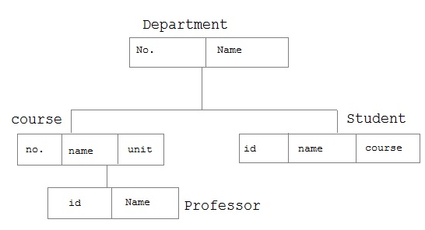
Hierarchical Model
It organize data into a tree like structure having one root or parent.
Here data starts from room with one to many kind of relationship
Department
Student
Course
Figure: 1.56 Hierarchical Model

Slide 115
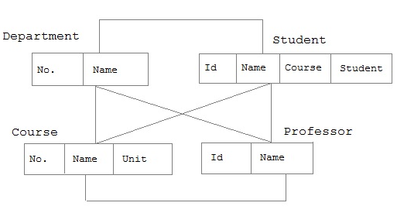
Network Model
It is an extension of hierarchical model, with many to many kind of relationship in tree structure with multiple parents.
Department
Student
Course
Professor
Figure: 1.57 Network Model

Slide 116
Relational Model
In this model data is organized in two-dimensional tables and relationship is retained by storing a common attribute.
Tables: Relations are saved in the format of tables. Table has rows and columns. Here rows denotes records and columns denotes attributes.
Tuple: A single row of a table which has a single record value is known as tuple .

Slide 117
Relational Model
Relation Instance: It is a finite set of tuples in a relation.
Relation schema: It describes relation name (table name), attributes, and their names.
Relation Key: Each tuple has one more attributes that identifies relation uniquely is known as relation key.
Attribute Domain: It is a predefined value scope of a every attribute.

Slide 118
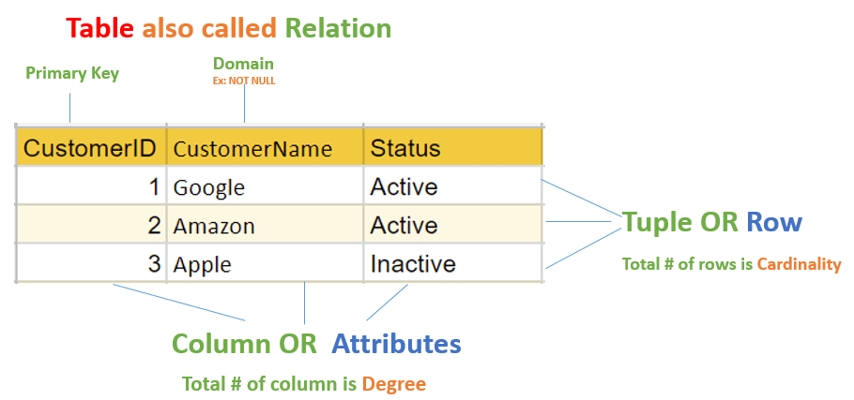
Relational Model
Figure: 1.58 Example Relational Model
(Image Source: https://www.guru99.com/relational-data-model-dbms.html)

Slide 119
Relational Model
Rno | Student_Name | Age
101 | Dilen Panchal | 22
102 | Sanket Patel | 21
SubID | Subject_Name | Teacher
1 | DBMS | Kiran
2 | OS | Abhijit
Foreign Key
Foreign Key
ResID | Rno | SubID | Marks
1 | 101 | 1 | 84
2 | 101 | 2 | 70
3 | 102 | 1 | 85
4 | 102 | 2 | 74
Figure: 1.59 Example Relational Model

Slide 120
Object-Oriented Model
This model follows the method of representing real world objects.
Objects are derived from real world entities and situations.
Each object has their own properties that are defined as attribute and their behavior is defined as methods.
Object is like an instance of class. So similar attributes and methods are grouped together as a class.

Slide 121
Object-Oriented Model
Shape
Area()
Perimeter()
Circle
Center
Radius
Triangle
Base
Height
Rectangle
Length
Breadth
Figure: 1.60 Example Object-Oriented Model

Slide 122
Integrity Constraints
Integrity constraints means set of rules defined in database system. It is used to maintain the quality of information.
It ensures that any data related operation performed on database like, data insertion, updating does not affect integrity of data.
It provide protection against any damage to database.
Following are different types of Integrity Constraints:
Check
Not null
Unique
Primary key
Foreign key

Slide 123
Integrity Constraints
Check:
Check integrity constraint defines a specific rule for a column, all the rows of that column must have to satisfy it.
Check controls the tuple values to some set, range or specific value.
It can be applied on more than one column of a relation(table).
Example: Tuple value of CGPA should be between 0 to 10

Slide 124
Integrity Constraints
Not Null
As name suggests all the rows of relation(table) should be some definite value for the column on which Not null is applied.
Simply when we apply this constraint on any column, it should have some value.
Example: For relation Student, Name column should have some value.

Slide 125
Integrity Constraints
Unique
As name defines it make sure that columns or group of columns in each row of table has unique (distinct) value.
Columns can have null values, but they can’t be duplicated.
This constraint sometimes also referred as Unique Key.
Example: For relation Student, Enrollmentno column should have unique value.

Slide 126
Integrity Constraints
Primary Key
Primary key applies to column or combination of columns to uniquely identifies each row in the table.
Primary Key = Unique key + Not null
There can be only one primary key per table
Example: For student relation table, EnrollmentNo column should have unique value and can’t be null.
EnrollNo | Student_Name | DeptID
001 | Ramesh | 1
002 | Suresh | 2
003 | Mahesh | 1
Primary Key
Figure: 1.61 Primary Key

Slide 127
Integrity Constraints
Foreign Key
Foreign key is defined to link two tables(relation).
Foreign key is set of one or more attributes whose value is derived from the primary key of another relation.
Foreign key is also known as referential integrity.
Attribute or column which is declared as foreign key in Table 1 is derived from primary key of Table 2 and every value of foreign key column in table 1 must be null or available in primary key of table 2.

Slide 128
Integrity Constraints
Foreign Key
Foreign
Key
Primary
Key
EnrollNo | Student_Name | DeptID
001 | Ramesh | 1
002 | Suresh | 2
003 | Mahesh | 1
DeptID | Dept_Name | HOD
1 | Computer | XYZ
2 | IT | ABC
Table 1
Table 2
Figure: 1.62 Example Foreign Key

Slide 129
Some other keys
Super Key: It is a set of one or more columns that identifies each tuple record uniquely in a relation.
Employee
Here entity sets {Emp_SSN}, {Emp_Number}, {Emp_SSN, Emp_Number}, {Emp_SSN, Emp_Name}, {Emp_SSN, Emp_Number, Emp_Name}, {Emp_Number, Emp_Name} are uniquely identifies rows so they all are super keys.
Emp_SSN | Emp_Number | Emp_Name
123 | 101 | Ramesh
456 | 102 | Suresh
789 | 103 | Dinesh
791 | 104 | Mahesh
Figure: 1.63 Super Key

Slide 130
Some other keys
Candidate Key: It is subset or part of the super key.
Sometimes they’re also known as minimal super key with no repeated attributes.
Each table has minimum one candidate key, but there can be multiple candidate keys also.
One Primary key is selected from candidate keys.
Example: {Emp_SSN} , {Emp_Number}
Alternate Key: Any candidate key that’s not chosen as a primary key is alternate key.

Slide 131
Data Manipulation Operations
Data Manipulation Operations are performed by DML commands
SELECT – retrieve data from a table
INSERT – insert new records
UPDATE – update/Modify existing records
DELETE – delete existing records

Slide 132
Data Manipulation Operations
INSERT
Syntax:
INSERT INTO table_name (column, column1, column2..) VALUES (value, value1, value2 ...);
Example:
INSERT INTO Students (Enroll_no, Student_name, Phone)
VALUES (1234567890, ’xyz’, 9876543210);

Slide 133
Data Manipulation Operations
UPDATE
Syntax:
UPDATE table_name SET column=value, column1=value1,...
WHERE someColumn=someValue;
Example:
UPDATE Student SET Phone = 987654321
WHERE Enroll_No = 123456789;

Slide 134
Data Manipulation Operations
DELETE
Syntax:
DELETE FROM tableName WHERE someColumn = someValue;
Example:
DELETE FROM Students WHERE Enroll_no=123456789;

Slide 135
References
[1] Abraham Silberschatz, Henry F. Korth and S. Sudarshan, Database System Concepts, McGraw-Hill Education (Asia), Seventh Edition, 2019.
[2] C. J. Date, A. Kannan and S. Swamynathan, An Introduction to Database Systems, Pearson Education, Eighth Edition, 2009.
[3] Database Management Systems, CSE, DIET, https://www.darshan.ac.in/DIET/CE/GTU-Computer-Engineering-Study-Material
[4] Database management systems by Raghu Ramakrishnan and Johannes Gehrke http://pages.cs.wisc.edu/~dbbook/openAccess/thirdEdition/slides/slides3ed.html
[5] Database management system tutorial, https://www.tutorialspoint.com/dbms/index.htm

Slide 136


www.paruluniversity.ac.in

